Slide 1
Introduction to
SAP

Slide 2
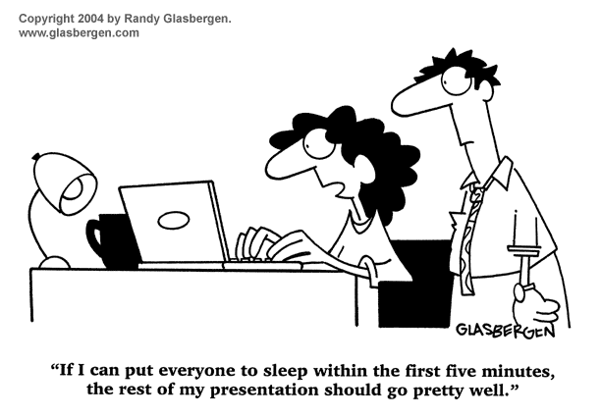
Quiz Time…
Notes:
This example shows how the business processes in assemble-to-order production proceed, when the system is customized accordingly.

Slide 3
Quiz Time…
Expand SAP
Systeme, Anwendungen, Produkte in der Datenverarbeitung
Systems and Applications Products in Data Processing
SAP was founded in the year ….?
1972
Notes:
This example shows how the business processes in assemble-to-order production proceed, when the system is customized accordingly.

Slide 4
SAP AG
Founded in 1972 by 5 former IBM employees
80,000 installations, 12 M users, 1500 partners, 13,500 organizations, 120 Countries
30,000 Employees in 50 countries
Third largest independent S/W provider
Headquartered in Walldorf, Germany
U.S. operations in Newtown square PA

Slide 5
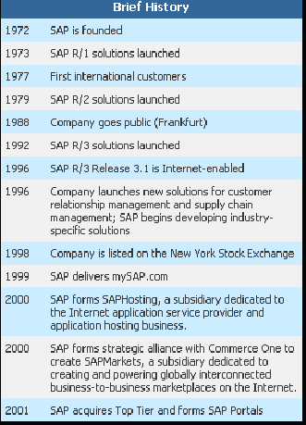

Slide 6
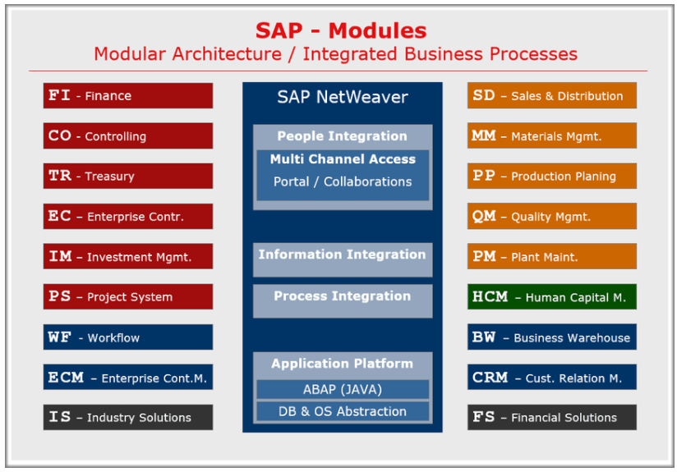

Slide 7
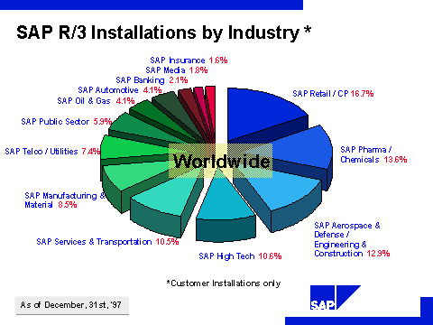

Slide 8
























Varioud Partnership and Strategic Alliances with Major Suppliers
CRM
Customer
Relationship
Management
e-Business solutions for CRM
e-Marketing
e-Business solutions for CRM
SCM
Engineering, PDM & CPC
Solutions
Engineering, PDM & CPC
Solutions
Engineering, PDM & CPC
Solutions
Supply Chain
Solutions
ERP
ERP Software
Vendors
ERP Software Vendors
ERP Software
Vendors
ERP Software
Vendors
TI
Middleware & eBusiness Infrastructure
Middleware & eBusiness Infrastructure
Middleware & eBusiness Infrastructure
eBusiness
Solutions
Hardware
Enterprise Systems
Enterprise
Systems
Enterprise
Systems
Enterprise
Storage
Services
Enterprise Systems

Slide 9
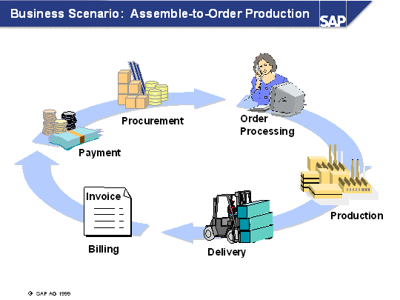
BUSINESS SCENERIO - PRODUCTION CYCLE
Notes:
This example shows how the business processes in assemble-to-order production proceed, when the system is customized accordingly.

Slide 10






Enterprise Integration Scenarios
Accounting
Purchasing
Shipping
Logistics
Human Resources
Information Systems
Notes:
Asynchronous processing has been utilized in many industries for well over 20 years. Many corporations chose to get out of the business of developing business systems and instead purchased SAP to meet their needs . The Microsoft BizTalk Adapter for SAP allows internal and external application links that provide access to the various modules of SAP as shown in this slide.
Help the customer understand the fact that Microsoft can help them build batch solutions today and will look to provide near real time solutions in the future by adding BAPI support.

Slide 11
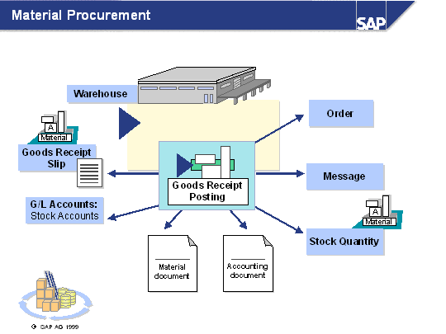
MATERIAL PROCUREMENT
Notes:
The procurement process for material BOM components may include a purchase order and the goods receipt for this purchase order. The purchase order can be generated by a purchase requisition.
For goods movement, a material document and an accounting document are created. For non-valuated goods receipts, for example free-of-charge deliveries or goods receipts to consignment stock (non-valuated stock), no accounting document is generated. The goods receipt types are determined using the Movement type parameter. The same applies for transfer postings and goods issues.
The material document describes the goods movement from the warehouse perspective. The accounting document describes the goods movement from the value flow perspective. From the material document display you can branch to the financial document display.

Slide 12
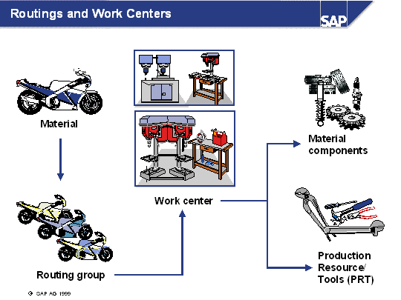
ROUTINGS AND WORK CENTERS
Notes:
Movable operating resource required for production. An example is a set of instructions, a tool, or a machine that is not stationary.

Slide 13
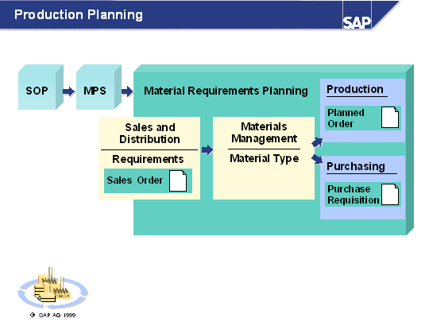
PRODUCTION PLANNING
Notes:
Production Planning is the process of using forecasts and customer demand to create production and procurement schedules for finished products and component materials. The overall manufacturing planning process is comprised of::
Sales & Operations Planning (SOP) uses forecast values and requirements from the sales information system and costing/profitability analysis as inputs for determining planned independent requirements. Planned independent requirements are planned quantities of a product over a given period of time and are not necessarily created on the basis of a customer requirement.
Master Production Scheduling (MPS) items (those items that greatly influence profits or consume critical resources) are planned. Planning the master schedule items separately leads to a reduction in stock levels and improved delivery performance. MPS is an optional step in the planning process.
The communication between Sales and Distribution and Production takes place via requirements.
Material Requirements Planning (MRP) is the final step in the planning process. The output of MRP is either a planned order or a purchase requisition.

Slide 14
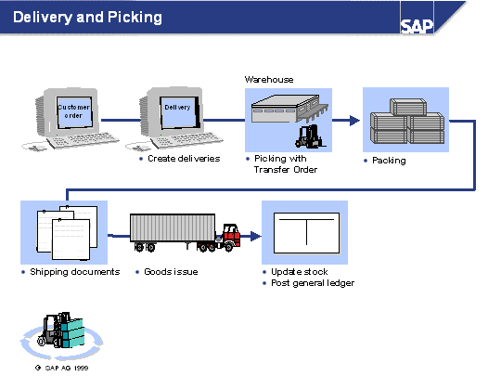
DELIVERY AND DISTRIBUTION
Notes:
A delivery triggers all the activities relevant for shipping such as picking, packing and transportation. A delivery is created within a shipping point for order items due for delivery to a goods recipient. The system copies the relevant data from the order to the delivery.
Within the delivery process the following steps are executed either automatically or manually:
Create the delivery document. Critical shipping information(i.e. ship-to-address, materials, quantities, and incoterms) is copied from the sales order.
Pick the items. A transfer order is created to facilitate picking.
Packing. Optional step that allows you to document the cartons, pallets and containers product has shipped in.
Post Goods Issue. This step confirms that the goods have left the plant. It automatically updates inventory balances and makes the appropriate entries in the general ledger. The delivery is also flagged as being ready for billing.
At each of the stages in the delivery process, it is possible to display deliveries “in progress.” This allows a particular delivery to be monitored, or for work lists to be generated to show those deliveries that need to move on to the next stage of processing.

Slide 15
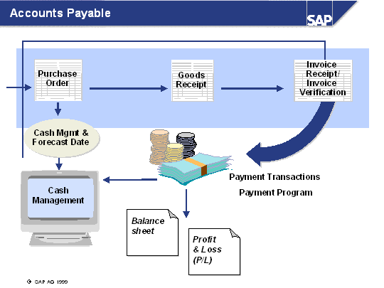
ACCOUNTS PAYABLE
Notes:
Cash Management
The liquidity forecast in Cash Management is continuously updated through purchase order processing in Materials Management. The financial status is updated by the outgoing payments.
Accounts Payable Sub-ledger
Open items due for payment are paid by the payments program. Correspondence, such as balance confirmations, are created. The operational activity is completed with the posting of the payment of the incoming invoice. To create the balance sheet, activities, such as valuations of open items in foreign currencies or the breakdown by payment of the remaining life, are carried out.
General Ledger
When goods are received, the inventories are updated continually and when the incoming invoices are posted, the payables and expenses are increased in the invoice verification. The cash inventories in bank accounts are correspondingly decreased by the outgoing payments and the payables are cancelled through clearing.

Slide 16
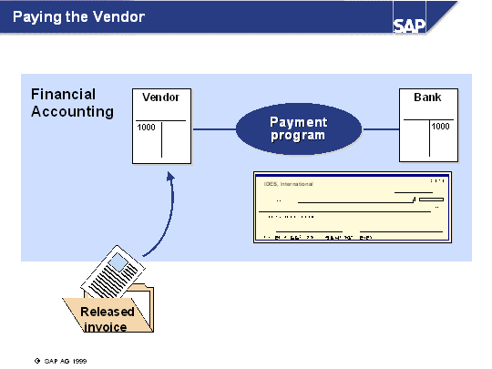
PAYING THE VENDOR : [Outgoing]
Notes:
The accounts payable system reads the vendors’ invoice files and pays all posted invoices due that are not blocked for payment. Payment runs can be automated to occur at specific times.
Payment is based on the payment terms specified in the purchase order or in the vendor master. This information can be changed manually on the invoice.
The payment program has been developed for international payment transactions with vendors and customers. You can carry out both outgoing and incoming payments.
The standard system contains the common payment methods and the corresponding forms, which have been defined separately for each country. The standard payment methods include check, transfer, and bill of exchange.

Slide 17

ACCOUNTS RECEIVABLE
Notes:
Cash Management
Sales order processing means that the liquidity forecast in cash management is continuously updated. The cash position is then updated when payment is received.
Accounts Receivable Sub-Ledger
The credit limit check is performed automatically when sales orders are created. Open items that have surpassed the payment deadline can be dunned and correspondence such as balance confirmations can be produced. Operational activities commence when either the payment is posted or partial payment of the invoiced amount is received. For creating balance sheets, activities such as valuing open items in foreign currency or splitting receivables according to remaining terms are performed in the subledger.
General Ledger
When deliveries are made to customers, balances are dynamically updated. When billing customers, the receivables and revenues for invoicing are increased. When payment is received, bank account monetary balances are respectively increased and receivables are reset in clearing.

Slide 18
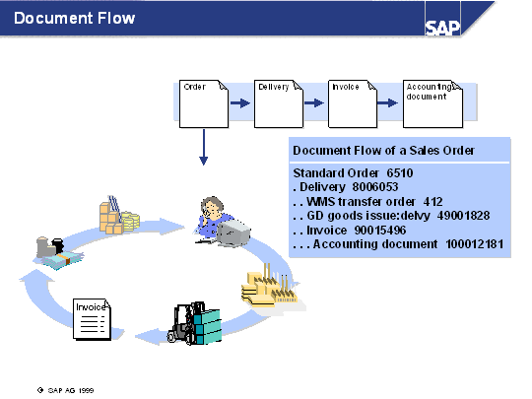
DOCUMENT FLOW
Notes:
Sales documents represent system transactions.
These transactions form a chain of related documents, which creates a document flow.
The system copies data from one document to another to reduce the manual data entry.

Slide 19
SAP R/3
SAP : Systems, Applications & Products in data processing”.
R/3 : Real Time 3 Tier Architecture
SAP R/3 is a suite of client-server, multi lingual customizable business modules which help integrating and improving business practices (conceptually similar to R/2).
SAP R/3 is fast becoming the worldwide standard of complementary hardware and software partners.
Major Implementation partners PwC, E&Y, Deloitte&Touche, Accenture,IBM etc

Slide 20
Advantages of the SAP R/3 System
Flexible Structure and Enterprise-Wide Integration
Real-Time Information
Best business practices to adopt and BPR
On-line Integrated graphics.
Supports Multiple Languages and multiple currencies
Notes:
The international strength of the products extends to every aspect of the applications, such as the support of multiple currencies simultaneously and the automatic handling of country-specific import/export, tax, and legal requirements

Slide 21
SD
Sales &
Distribution
FI
Financial
Accounting
MM
Materials
Mgmt
CO
Controlling
PP
Production
Planning
R/3
Client/Server
ABAP/4
AM
Fixed Assets
Mgmt.
QM
Quality
Mgmt.
PS
Project
System
PM
Plant Main-
tenance
WF
Workflow
HR
Human
Resources
IS
Industry
Solutions

Slide 22
Sales and Distribution
Computer Aided Sales
Quotations
Sales Order Management
Pricing
Delivery
Invoicing
SD
© 19xx SAP America, Inc. All rights reserved.
© 1996 Deloitte & Touche Consulting Group/ICS. All rights reserved.

Slide 23
Materials Management
Procurement
Inventory Management
Vendor Evaluation
Invoice Verification
Warehouse Management
MM
© 19xx SAP America, Inc. All rights reserved.
© 1996 Deloitte & Touche Consulting Group/ICS. All rights reserved.

Slide 24
Production Planning
Sales & Operations Planning
Demand Management
Material Requirements Planning
Production Activity Control
Capacity Planning
PP
© 19xx SAP America, Inc. All rights reserved.

Slide 25
Financial Accounting
General Ledger
Accounts Receivable
Accounts Payable
Tax and Financial Reports
Special Purpose Ledger
Legal Consolidations
FI
© 19xx SAP America, Inc. All rights reserved.
© 1996 Deloitte & Touche Consulting Group/ICS. All rights reserved.

Slide 26
Controlling
Cost Center Accounting
Profit Center Accounting
Product Cost Controlling
Profitability Analysis
Activity Cost Management
Internal Orders
CO
© 19xx SAP America, Inc. All rights reserved.

Slide 27
Fixed Asset Management
Depreciation
Property Values
Insurance Policies
Capital Investment Grants
AM
© 19xx SAP America, Inc. All rights reserved.

Slide 28
Project System
Project Tracking
Work Breakdown Structure
Budget Management
Cost and Revenue Planning
Networks and Resources
PS
© 19xx SAP America, Inc. All rights reserved.

Slide 29
Plant Maintenance
Representing/Structuring Technical Systems
Maintenance Planning
Maintenance Notifications
Maintenance Orders
Resource Planning
PM Info System
PM
© 19xx SAP America, Inc. All rights reserved.

Slide 30
Quality Management
Quality Planning
Quality Notifications
Quality Costing
Quality Control
QM Info System
QM
© 19xx SAP America, Inc. All rights reserved.

Slide 31
Human Resources
Personnel Administration
Payroll, Benefits
Time Management
Planning and Development
Organization Management
HR
© 19xx SAP America, Inc. All rights reserved.

Slide 32
SAP Organizational Units
Client
Terminology
Company
Company
Plant
Plant
Plant
Plant
Plant
Storage
Location
Storage
Location
Storage
Location
Storage Location
Storage Location
© 19xx SAP America, Inc. All rights reserved.

Slide 33
SAP Organizational Units
.
Client
Example
U.S.
Canada
Company
Phila.
(Bikes)
Plant
Raw
materials
Finished
products
Storage Location
© 19xx SAP America, Inc. All rights reserved.

Slide 34
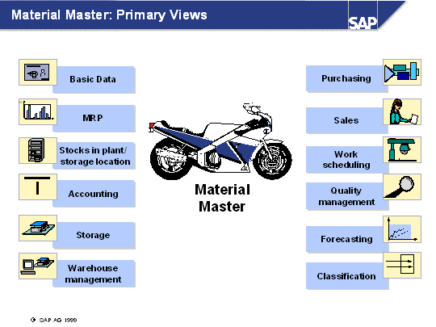
Material Master – Various Views
Notes:
The material master represents the central source for releasing material-specific data. It is used by all of the SAP Logistics components in the R/3 System.
The stored data can be used by all areas, such as purchasing, inventory management, materials planning, invoice verification, and so on.
For example, the data contained in the material master is required by the following functions in the SAP Logistics component:
Ordering in Purchasing
Updating movement of goods and managing the physical inventory in Inventory Management
Posting invoices in Invoice Verification
Processing sales orders in Sales
Planning requirements, scheduling work in Production Planning and Control

Slide 35
Typical Organization
Customer
Customer
Warehouse
Sales
Vendor
Production
Customer
Purchasing
Finance
Vendor
Vendor
Functions are separate
Interface and communication links with other Functions.
Variety of systems
Each function maintains its own master data
Duplication of data entry

Slide 36
SD
FI
MM
CO
PP
SAP
R/3
HR
SD
SD
SD
Sales & Distribution . . . . . . . .

Slide 37
Sales and Distribution Process
Sales
Activities
Inquiry
from
Customer
Quotation
to
Customer
Contract
Sales
Order
Functions
Finance/Accounts
Receivable
Delivery
Transport
Customer
Payment
Customer
Invoice
Shipment
Inventory
Management
© 1996 Deloitte & Touche Consulting Group/ICS. All rights reserved.

Slide 38



Order Entry
PP
PP
MM
FI
MM
FI
FI
Sold to party: C100
Item Material Qty
Credit Management
Dynamic Availability Check
Cash Forecast
10 6301 10
20 6412 10
30 1507 25
.
.
.
.
Order
?
  OK
?
Sales Rep.

Slide 39



Delivery / Shipment Processing
MM
WM
FI
FI
MM
MM
MM
Sold to party: C100
Item Material Qty
Credit Management
  Static Availability Check
10 6301 10
20 6412 10
30 1507 25
.
.
Order
.
Order
Picking
List
.
Picking
  Packing
  Transportation

Slide 40
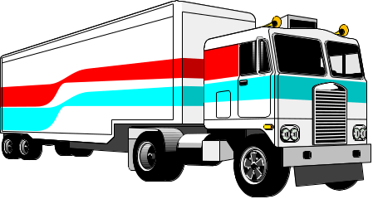



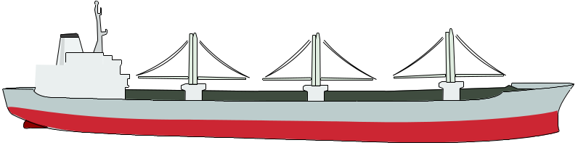

Goods Issue
FI
MM
Goods issue
" integrated flow of quantity and values"

Slide 41
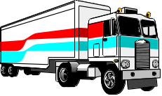

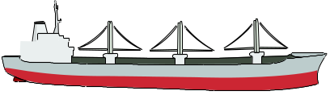
Postings in FI: General Ledger
Balance sheet
Finished goods
1000
300
Income
statement
Costs of goods sold
300
SD

Slide 42
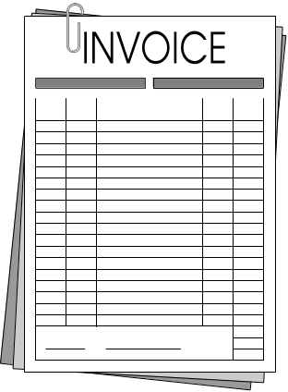

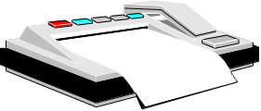

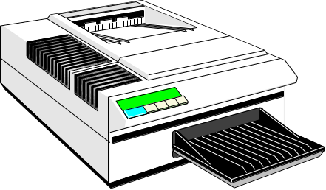
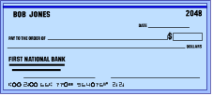
Invoicing
CO
PA
Profit center accounting / Profitability analysis
Accounts receivable / General Ledger
Cash Forecast
CO
PCA
FI
FI
Single invoices
  Collective invoices
  Invoice lists
  Credit / debit notes
EDI

Slide 43










Accounts Receivable
FI
Accounts receivable / General Ledger
Cash
n
1000
Customer
1000
1000
n
SD
Customer Payment

Slide 44
SD
FI
MM
CO
PP
SAP
AM
QM
R/3
PM
MM
SD
Materials Management. . . . . . .

Slide 45
Materials Management Process
Quota arrangement
Source List
Purchase
Requisition
Vendor
Selection
Outline Agreement
Purchase
Order
Business
Purchasing
Functions
Finance/Accounts
Payable
Warehouse
Goods
Receipt
Vendor
Payment
Invoice
Verification
Inventory
Management

Slide 46
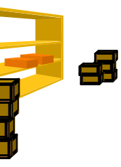
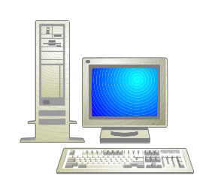
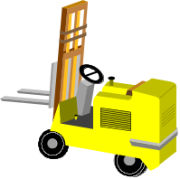
Material Requirements Planning
Requisitions
direct requests
consumption
  + demand
  driven MRP
PP
MM
SD

Slide 47



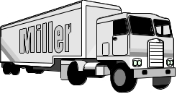
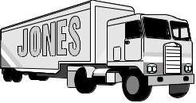


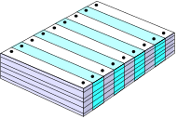
Procurement
CO
FI
Cash forecast
  Orders / Projects / Cost centers
vendor 1
vendor 2
vendor 3
?
?
MRP
purchase
requisition
Source
list
Determine
  source
  of
  supply
Outline
agreement
Release
procedure
Release
  purchase
  order
purchase requisition
purchase requisition
© 19xx SAP America, Inc. All rights reserved.

Slide 48

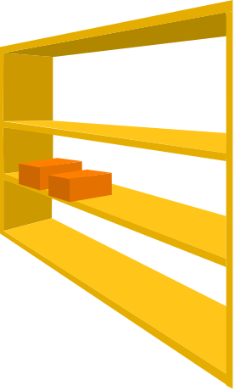


Goods Receipt
CO
QM
FI
Orders / Projects / CC
  G/L accounts posting
  Quality inspection
vendor 3
Vendor evaluation
  PO histories
  Purchasing information
  system
  Inventory controlling
goods
receipt
© 19xx SAP America, Inc. All rights reserved.
Notes:
Transactions that lead to changes in stock levels, such as goods receipts, return deliveries, planned and unplanned stock withdrawals, stock transfers and stock adjustments, are handled within the component. Through real-time entry, checking and correction of goods movements, data is kept as up-to-date as possible and error levels are reduced to a minimum. This is an essential prerequisite for accurate and efficient materials planning and control.
At the time of goods receipt, all relevant data is defaulted from the purchase order. The system keeps track of underdeliveries and overdeliveries. Each material movement causes the quantities of stock on hand to be updated. Stock values are updated via the automatic account determination facility.

Slide 49




Invoice Verification
FI
CO
FI
CO
Orders / Projects /Cost centers
G/L accounts / Accounts payable
Payment
Vendor
invoice
vendor 3
Tolerance check ?
  blocked invoice
OK !
Invoice
  verification
Delivery invoice
        Preliminary posting
        Automatic price update
e.g.
release of
blocked invoice
Notes:
The invoice verification (invoice matching or invoice clearance) functionality demonstrates the degree of integration particularly clearly. Information is available from the material master record, the purchase order and goods receipts. In the ideal case, the user need only enter the invoice sum total for the items of the purchase order. In the event of agreement with the pre-planned values, all postings are effected and the invoice is released, or cleared, for payment. If pre-set tolerances are exceeded (e.g. for quantity, price and delivery date) payment of the incoming invoice is blocked.

Slide 50
Inventory Management
Main Storage
Loc.1
Loc.2
Loc.3
Vendor
Customer
Transfer
Plant
Goods
Receipt
Goods
Issue
Plant
PLANT
Plant
Plant
Stock
count
Production Line
Raw
Material
Finished
Material

Slide 51
If you want more….
Forums and Clubs
Deloitte SAP Forums
Sapfans.com
Sdn.sap.com
Sapgenie.com
Deloitte SAP Resources
Notes:
Asynchronous processing has been utilized in many industries for well over 20 years. Many corporations chose to get out of the business of developing business systems and instead purchased SAP to meet their needs . The Microsoft BizTalk Adapter for SAP allows internal and external application links that provide access to the various modules of SAP as shown in this slide.
Help the customer understand the fact that Microsoft can help them build batch solutions today and will look to provide near real time solutions in the future by adding BAPI support.

Slide 52
Q&A

